Slide 1


Predicting Vaccination Rates for H1N1 and Seasonal Flu

Slide 2



Meet the Team
Isabella Oakes
Sarah Alqaysi
Omar Elfeky
MSADS
MSADS
MSADS
University of San Diego
University of San Diego
University of San Diego
Page 1

Slide 3






Table of Contents
Project Background
Problem Statement
Data Acquisition and Aggregation
Exploratory Data Analysis
Data Quality
Feature Engineering
Modeling
Results and Findings
Conclusion and Next Steps
References
Page 2
Get Started

Slide 4

Project Background
Vaccination is a vital medical industry invention
Effective at preventing the spread of disease
Mandatory vs. optional vaccinations
Page 3

Slide 5


Project Problem
Reduction of nearly 105,000 hospitalizations due to the seasonal flu with vaccinations
About half of adults are vaccinated
Vaccine polarization is a widespread issue
Vaccinations help reduce risk to self, as well as others in the community
Goal is to find ways of increasing likelihood of choosing to get vaccinated
Page 4

Slide 6

Data Acquisition
Data is downloaded from DrivenData (2020)
Data consists of two CSV files with 26,707 rows and a respondent ID
Training data contains 35 features and training labels contain two targets (H1N1 vaccine and seasonal flu vaccine)
Features include 23 numerical features, 13 of them binary, and 12 categorical features
Data is combined on the respondent ID to create one dataframe
Page 5

Slide 7
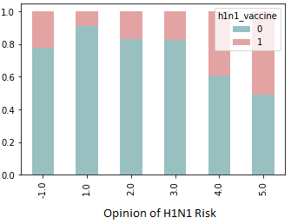
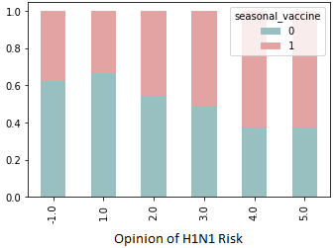

Exploratory Data Analysis
Five features and both targets have zero null values
Other features range between 19 and 13,470 null values
Numerical null values are set to -1 and categorical values are set to ‘no_response.’
The H1N1 vaccine target is more heavily skewed toward ‘no’ while the seasonal flu vaccine target was close to equally distributed between ‘yes’ and ‘no’ responses
Opinion of H1N1 Risk by Target
Note. Normalized Bar Plot Exploring Relationship between Opinion of H1N1 Risk and Targets
Page 6

Slide 8
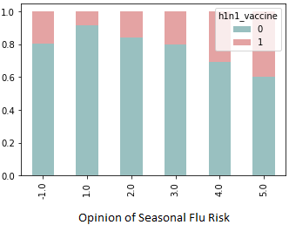
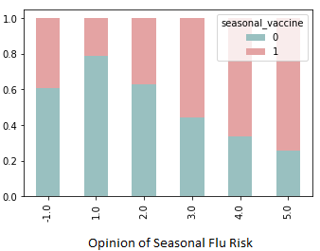

Exploratory Data Analysis
Opinion of Seasonal Flu Risk by Target
Most features have less than 10% correlation to the features
Eight features have correlation higher than 10% with the H1N1 vaccine target
Fifteen features have correlation higher than 10% with the seasonal flu target
The Seasonal flu vaccine is more highly correlated with opinions of H1N1 risk than H1N1 vaccine as shown on the graph
Note. Normalized Bar Plot Exploring Relationship between Opinion of Seasonal Flu Risk and Targets
Page 7

Slide 9


Data Quality
Data is overall clean except for null values
Data is anonymous, hence, the likelihood of responders with honest responses are high
Employment industry and occupation have highest number of responses available (25)
Page 8

Slide 10


Feature Engineering
Features are converted to categorical variables from numbers using category encoding
Nulls handled with encoding, imputing median, and removing rows with null values
Respondent ID is irrelevant and removed
Class balancing
Feature scaling: Two techniques are applied to the dataset—normalization and standardization using the scikit library
Page 9

Slide 11
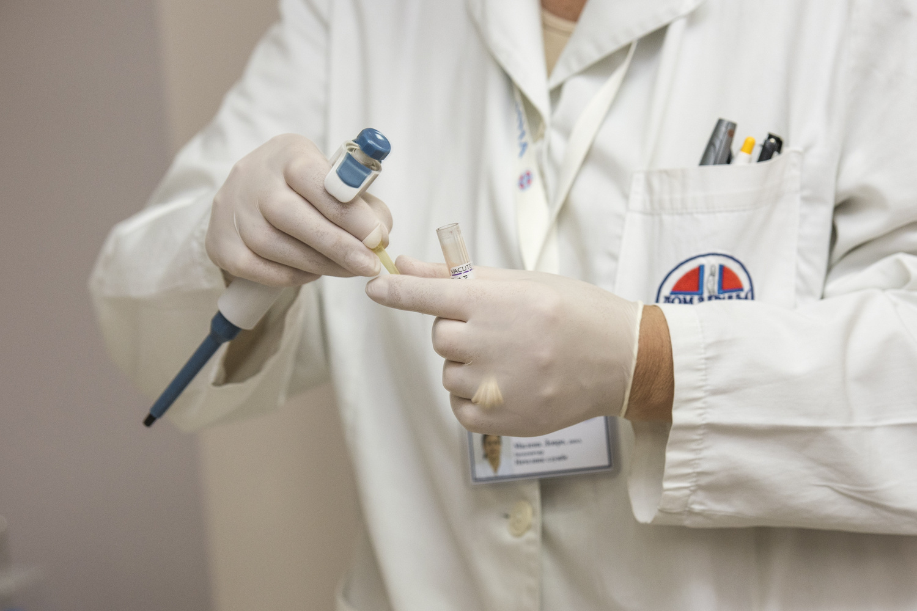



Modeling
The initial models used are K-Nearest Neighbors, K-means, Support Vector Machine, Linear Regression, Logistic Regression, Naïve Bayes, Neural Network, Random Forest and Adaboost
For selection of modeling techniques, F1-scores with the default hyperparameters is used for initial tuning
Using a grid-search to explore the hyperparameters is deemed the best method to systematically find the best results
The top three models for each target are tuned to find optimal hyperparameters
Page 10

Slide 12
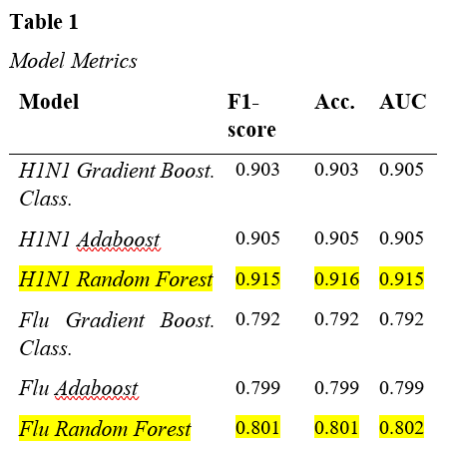
Results and Findings
The best performing models were initially evaluated based on their F1-scores
The top models are then tuned for optimal hyperparameters, and the tuned models trained and used to make predictions on the validation dataset
As Table 1 shows, the top model for both targets was the Random Forest model
Page 11
Notes:
The short-listed models were the Gradient Boost, Random Forest, and Adaboost. This comes as no surprise since these models are ensemble based. That is to say that they are resistant to over-fitting since each consist of an array of minor models voting and the over vote is what is used for prediction. We judged the final contestants using their F-1 score, accuracy and AUC scores. It is important to note that a high f1-score is more meaningful statistically than the accuracy score.

Slide 13
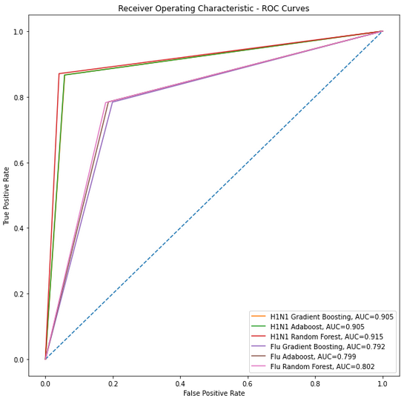
Results and Findings
A graph of the area under the receiver operating characteristic curve (AUC ROC) used to visualize results
Top three models for each target are shown
Page 12
Notes:
ROC is a probability curve and AUC represents the degree or measure of separability. The higher the AUC the better the model is at separating the classes, whereas the ROC plot is of the distribution of probability. The blue dotted line at the 45 degree angle is the performance of a completely random model. Generally for the H1N1 models the classes are correctly predicted 90% of the time unlock the Seasonal Flu models that only get it right 80% of the time.

Slide 14
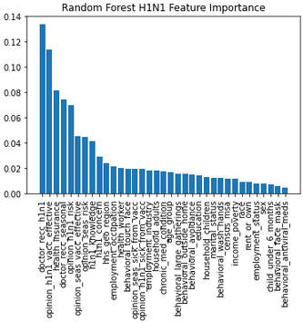
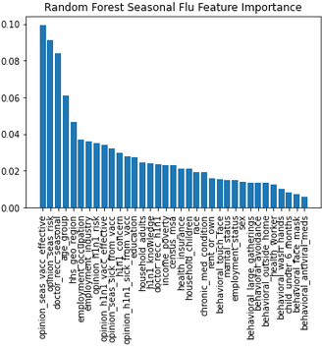
Results and Findings
Feature importance: Top features for the seasonal flu model fall off in importance after 3, 4, and 5 features
Feature importance: Top features for the H1N1 model
drop off in importance after 1, 2, and 5 features
Page 13
Notes:
If processing and time limitations are in place when deploying the model we could limit feature selection using the less important features. The best way to do so would be to do a PCA transform.

Slide 15

Conclusion and Next Steps
Vaccinations will continue to follow a similar trend unless they are promoted
One way of encouraging people to get vaccinated is through their workplace
Providing more information through trusted sources on social media can also help increase awareness
Providing facts along with examples can have a big impact on how vaccines, or not getting vaccinated, can change people’s lives
Since the adoption of vaccines is a binary choice, we can modify the classification threshold from 0.5 to a lower value
Updated surveys and information
Page 14
Notes:
Without a fact based and coherent vaccination policy the poor uptake trend will continue. Previously availability and ease of vaccinations uptake were a big factor in explaining adoption rates. Providing vaccines at the workplace can reach more individuals by increasing accessibility. The extreme vaccine hesitancy towards COVID vaccines might be partly explained by early prioritization of vaccines to the immunocompromised and elderly. People get mixed signals by the inconsistent messaging of authorities while the anti-vaxer movement is more consistent.

Slide 16


Thank you for your time and attention.
Page 16

Slide 17
References
Ankomah, A. A., Moa, A., & Chughtai, A. A. (2022). The long road of pandemic vaccine development to rollout: A systematic review on the lessons learnt from the 2009 H1N1 influenza pandemic. American Journal of Infection Control, 50, 735-742. https://doi.org/10.1016/j.ajic.2022.01.026
Ayachit, S. S., Kumar, T., Deshpande, S., Sharma, N., Chauasia, K., & Dixit, M. (2020, December). Predicting H1N1 and Seasonal Flu: Vaccine Cases using Ensemble Learning approach. 2020 2nd International Conference on Advancing in Computing, Communication Control and Networking (ICACCCN), 172-176. https://doi.org/10.1109/ICACCCN51052.2020.9362909
Bonnevie, E., Smith, S. M., Kummeth, C., Goldbarg, J., & Smyser, J. (2021, March 31). Social media influencers can be used to deliver positive information about the flu
vaccine: findings from a multi-year study. Health Education Research, 36(3), 286-294. https://academic.oup.com/her/article/36/3/286/6319647
Centers for Disease Control and Prevention. (2012). National 2009 H1N1 Flu Survey (NHFS). https://www.cdc.gov/nchs/nis/data_files_h1n1.htm
Centers for Disease Control and Prevention. (2021a). Quadrivalent Influenza Vaccine. https://www.cdc.gov/flu/prevent/quadrivalenthtm
Centers for Disease Control and Prevention. (2021b, August 26). What are the benefits of flu vaccination? https://www.cdc.gov/flu/prevent/vaccine-benefits.htm
Dinerstein, C. (2018, October 26). Influenza Vaccination Is Global, But Not The Same. American Council on Science and Health. Retrieved July 8, 2022, from
https://www.acsh.org/news/2018/10/26/influenza-vaccination-global-not-same-12504
DrivenData. (2020). Flu Shot Learning: Predict H1N1 and Seasonal Flu Vaccines. DrivenData.https://www.drivendata.org/competitions/66/flu-shot-learning/page/210/
Ferdinands, J. M., Thompson, M. G., Blanton, L., Spencer, S., Grant, L., & Fry, A. M. (2021, June 2). Does influenza vaccination attenuate
the severity of breakthrough infections? A narrative review and recommendations for further research. Vaccine, 39(28), 3678-3695.
https://doi.org/10.1016/j.vaccine.2021.05.011
Marcell, V. & Spurlock, W. R. (2020, October 1). Beliefs and Barriers Towards Flu Vaccination Among College Students. The ABNF Journal, 31(4), 108-112.Salo-Tuominen, K., Teros-Jaakkola, T., Toivonen, L., Ollila, H., Rautava, P., Aromaa, M., Lahti, E., Junttila, N., & Peltola, V. (2022, May 4). Parental socioeconomic and psychological determinants of the 2009 pandemic influenza A(H1N1) vaccine uptake in children. Vaccine. https://doi.org/10.1016/j.vaccine.2022.05.012
Sanders-Jackson, A., Gonzalez, M., Adams, R. B. & Rhodes, N. (2021, August 12). Social determinants of flu vaccine uptake among racial/ethnic minorities in the United States. Preventative Medicine Reports, 24. https://doi.org/10.1016/j.pmedr.2021.101516
Thompson, M. G., Pierse, N., Huang, Q. S., Prasad, N., Duque, J., Newbern, E. C., Baker, M. G., Turner, N., & McArthur, C. (2018,
September 18). Influenza vaccine effectiveness in preventing influenza-associated intensive care admissions and attenuating severe disease
among adults in New Zealand 2012–2015. Vaccine, 36(39), 5916-5925. https://doi.org/10.1016/j.vaccine.2018.07.028
Tosh, P. K. (2021, May 18). What’s the difference between H1N1 flu and influenza A? Mayo Clinic. https://www.mayoclinic.org/diseases-conditions/swine-flu/expert-
answers/influenza-a/faq-20058309
Page 17

